Slide 1
AIGA DESIGN CENSUS in partnership with Google
Marketing & Communications Kit
November 2016

Slide 2

Marketing & Communications Kit
Components
What is the Design Census?
Announcing the survey: sample emails (short, medium, long versions)
Design Census Day: promoting the census within your organization
After the survey: sample emails to bring the census results to life
Social media sample messages
Hashtags/handles
Quotes
Visual assets

Slide 3
Marketing & Communications Kit
Timing
December 1: Census launches
December 8: Design Census Day
December 16: Census closes
January 10: Census visualization gallery opens

Slide 4

Marketing & Communications Kit
What is the Design Census?
The Design Census is a new collaboration from AIGA and Google. The free and open-source resource will equip the modern designer with a critical understanding of the complex economic, social, and cultural factors shaping the design practice today.
The online survey will launch December 1 and close December 16, 2016, capturing everything from salary range to demographics, locations, disciplines, and industry-specific challenges—even how much coffee designers drink each day. Participants will spend approximately 15 minutes answering 50 questions, the results of which will be available to the public to help empower the global design community.
The Design Census is an evolution of AIGA’s respected Annual Design Salary Survey, a highly anticipated member service since 1994. The salary survey has been an invaluable resource, enabling designers to better navigate the complex economic ecosystem of the design industry and advocate for the value of their profession.
The Design Census will build upon the previous annual survey model by providing new, unique opportunities for co-creation, data interpretation, and data visualization. AIGA will publish its own report and curate a series of visualizations, enlisting award-winning data visualization consultancies SosoMedia and Maga Design to create dynamic portraits of the design community.
But the Design Census is only as good as its participants. The more people who participate, the more rich the data will become for all. The following communications kit will help you easily promote the message with ready-made email copy, along with several sample social media posts and visual assets for your use.
This is more than a salary survey. This is an opportunity to learn about your peers, the global design community, and your place in it. The results will be shared early next year, after which we will announce an open call to visualize the data. For more information on the census, contact Frank Migliorelli (frank_migliorelli@aiga.org). To become a partner in Design Census 2017, contact Vanessa Crews (vanessa_crews@aiga.org).

Slide 5

Marketing & Communications Kit
Announcing the survey (short copy)
Subject Line:
Be heard, be counted. Design Census launches December 1, 2016
Body Copy:
AIGA and Google Design invite you take part in the inaugural Design Census, launching December 1, 2016. The survey will capture everything from demographics to industry-specific challenges to how much coffee designers drink each day. The insights will be shared globally and empower designers with open-source data about our rapidly evolving profession. Take the census, then dive into the findings to learn more about your peers, the design community, and your place in it. For more information visit: designcensus.org.
designcensus.org, December 1–16, 2016
Use this suggested text in an email to your partners, members, or employees.

Slide 6
Marketing & Communications Kit
Announcing the survey (medium copy)
Use this suggested text in an email to your partners, members, or employees.
Subject Line:
Be heard, be counted. Design Census launches December 1, 2016
Body Copy:
Google and AIGA invite you to take part in the inaugural Design Census—an open and collaborative resource for understanding the complex economic, social, and cultural factors shaping the design practice today. It’s free and open to everyone, and the data will ultimately empower the design community to take charge of its professional development and happiness.
Sign up now at designcensus.org, to get your link to the survey which launches December 1 and closes December 16, 2016. Spend just 15 minutes to answer the 50 questions that will capture everything from salary ranges to demographics, locations, disciplines, and industry-specific challenges—even how much coffee designers drink each day.
The open-source data will be published early next year, after which the design community will be invited again, this time to download, interpret, and visualize the results.
Design Census is more than a salary survey. Get involved today and learn about your peers, the global community, and your place in it.
designcensus.org, December 1–16, 2016

Slide 7
Marketing & Communications Kit
Announcing the survey (long copy)
Subject Line:
Be heard, be counted. Design Census launches December 1, 2016
Body Copy:
Google and AIGA are pleased to announce the inaugural Design Census—an open-source platform for understanding the complex economic, social, and cultural factors shaping the design practice today.
The census launches December 1 and closes December 16, 2016. Until then, get involved by joining the official census mailing list at designcensus.org to receive updates and information.
Over the years, AIGA has conducted a profession-defining design salary survey. This year, in partnership with Google, the survey is broadening its scope to capture information and insights beyond salary information—including work habits, lifestyle, education, professional development, and beyond. The 50-question survey, free and open to all, will take approximately 15 minutes. The collected results will empower the design community to take charge of its professional development and happiness.
The results will be published early next year, after which the design community will be invited once more to download, interpret, and visualize the open-source data. These will be displayed in an online gallery at designcensus.org after January 10, 2017.
[Include some closing text, personalizing the context of this note with the importance of participation. Examples:
“We here at “BIG DESIGN AGENCY” or “BIG CREATIVE ASSOCIATION” are truly excited by the potential of this project. Please consider participating in the survey today, and help the“BDA/BCA” community make an impact on this important work. Thank you.”]
designcensus.org, December 1–16, 2016
Use this suggested text in an email to your partners, members, or employees.

Slide 8

Marketing & Communications Kit
Design Census Day
What: Design Census Day, an opportunity to host a fun, engaging event and rally your community to take the census together.
Why: The more people participate, the richer the day will be for all. This is an easy way to activate designers and even begin brainstorming together about how to visualize the survey results.
When: We’re suggesting Thursday, December 8, 2016. But please pick a date between December 1 and December 16 that works best for you and your team.
How: Below are some ways to get creative and plan your event. The idea is to set time aside to take the 15-minute survey as a group.
Organize an informal breakfast at your office, company café, or local coffee shop
Turn it into a party activity at your chapter or office holiday social
Host it during your next monthly Drinks with Designers, Sunday Sketching, or Drink and Draw event
Set up a Design Census booth at your Holiday Maker’s Mart
Work it into a weekly team meeting or development event
And don’t forget to share your thoughts and snapshots on #designcensus16
Who: All designers, including leaders, managers, and supporters in the design profession.
Where: Promote your event within your team and networks, and use #designcensus16 to share it on social media channels.
Increase participation with this simple get-together

Slide 9

Marketing & Communications Kit
After the Survey (call for data visualization)
Subject Line:
Help bring the Design Census to life
Body Copy:
You’re invited to contribute to the Design Census 2016’s online gallery and help this groundbreaking data come alive.
The Design Census will collect comprehensive data from the design community during December. This innovative project, spearheaded by AIGA and Google, will share the results in an open data set for anyone to download, visualize, and publish their interpretations.
Here’s where you come in: The design community is uniquely poised to take this data and create visualizations, reports, illustrations, and other interpretations to be shared with the world. In early January, once the census data is available to the public, everyone is invited to submit interpretations of the data, which will be featured in an online gallery on designcensus.org. We want to see your ideas, thoughts, and takeaways from this census.
What do I do with this data?
If you work in the field of infographics or data visualization, this is a chance to take raw information and create a visual representation of the data. For example, is there a creative way to display the range of salary numbers? Is there a fun way to represent how many cups of coffee the design community consumes? Have fun with these messages.
What if I don’t do infographics or data visualization?
Don’t worry—there are so many stories to extract from the data, and even more ways to tell them. We’re also interested in commentary, essays, briefs, and other written interpretations of the data, as well as visual interpretations like a creative poster, diagram, series of charts, graph, or video.
How do I get involved?
This is your invitation. If you’re interested, contact Frank Migliorelli (frank_migliorelli@aiga.org).
Thank you for your participation. We look forward to building a valuable resource for the global design community.
Use this suggested text in an email to your partners, members, or employees.

Slide 10

Marketing & Communications Kit
Social media messages
Let your voice be heard. designcensus.org launches December 1 #designcensus16
Want to shape the future of design? designcensus.org launches December 1 #designcensus16
.@AIGAdesign + @GoogleDesign announce the first design census. Sign up: designcensus.org #designcensus16
We want to understand the state of design + the people who make it: YOU. So we're launching #designcensus16 12/1: designcensus.org
Visit designcensus.org to sign up for #designcensus16 notification email; opens 12/1/16
AIGA wants to understand the state of design + the people who make it: YOU.
Along with Google Design, AIGA is launching the first-ever Design Census—an open + collaborative resource for understanding the complex economic, social, and cultural factors that shape the design practice today. Free, open to all, and driven by a goal to empower the design community.
Ready? Click the link + go to the “sign up” tab; you’ll be notified once the survey is open on December 1 + get exciting updates before the launch.
http://designcensus.org/ #designcensus16
AIGA + Google Design are thrilled to announce the inaugural design census. It opens December 1, 2016 and will capture everything from demographics + industry-specific challenges to how much coffee designers drink each day.
This census is for all designers + it’s free and entirely open source. The more people participate, the more the rich the data will be, so please share this post w/ your design community.
Sign up: http://designcensus.org #designcensus16
AIGA wants to understand the state of design + the people who make it, aka YOU. Along with Google, AIGA launches the first-ever Design Census—an open + collaborative resource for understanding the complex economic, social, and cultural factors that shape the design practice today. Want to be part of it? Click the link + sign up.
http://designcensus.org/
Twitter
Facebook
LinkedIn

Slide 11

Marketing & Communications Kit
Hashtags/handles
#designcensus16
Twitter @AIGAdesign
Instagram @AIGAdesign
Facebook AIGAdesign
LinkedIn linkedin.com/company/aiga

Slide 12

Marketing & Communications Kit
Quotes
“We are delighted to partner with Google to make data about designers open to everyone. Our hope is to provide information that the global design community will use to illuminate their options and advance the value of design and designers in government, business, media, education, and across sectors,” says Julie Anixter, executive director of AIGA.
“Google Design is a proud partner in the creation of the Design Census, an open effort to better understand our industry, practices, and community. By making today’s design information accessible to all, we hope that we can make more informed decisions about design tomorrow,” says Jonathan Lee, creative director of Google.

Slide 13



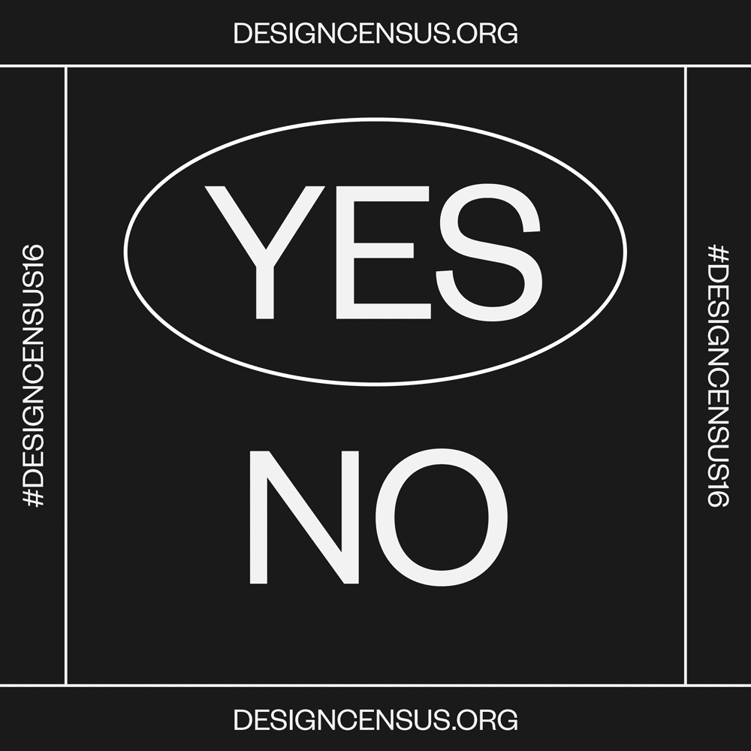




Marketing & Communications Kit
Assets

Slide 14



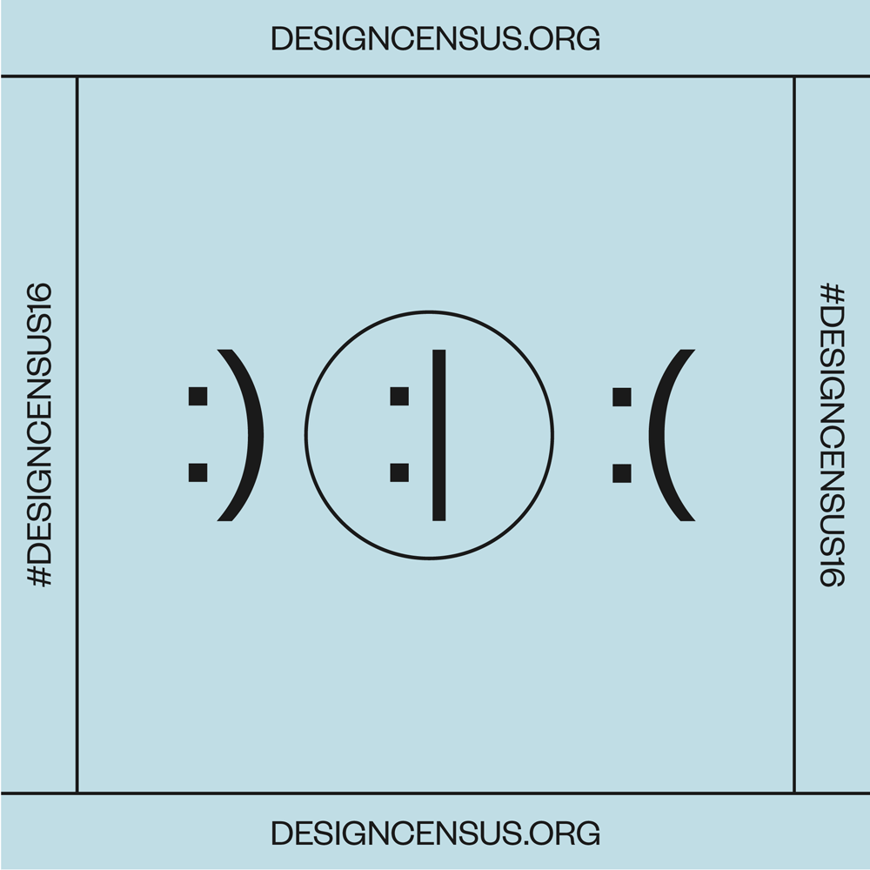



Marketing & Communications Kit
Assets

Slide 15








Thanks!
AIGA National Partners
For more information on the census, contact Frank Migliorelli (frank_migliorelli@aiga.org)
To become a partner in Design Census 2017, contact Vanessa Crews (vanessa_crews@aiga.org).
Supporting Partners

